Slide 1
Doubling down on states for strong growth
Maria
Senior Sales Analyst
March 15th, 2012

Slide 2
Today’s question
In which states should we invest additional marketing spend during the upcoming campaign?
Based upon sales growth potential…

Slide 3
Useful metrics
Total sales per state
Total sales per million residents:
per capita is better than looking at existing customers, because we want new customers
Top five states to target:
90th percentile +

Slide 4
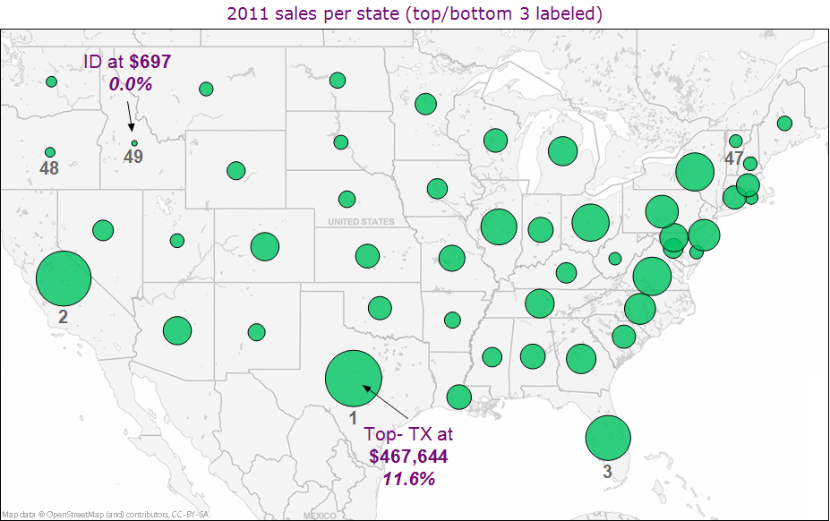
2011 sales by state

Slide 5
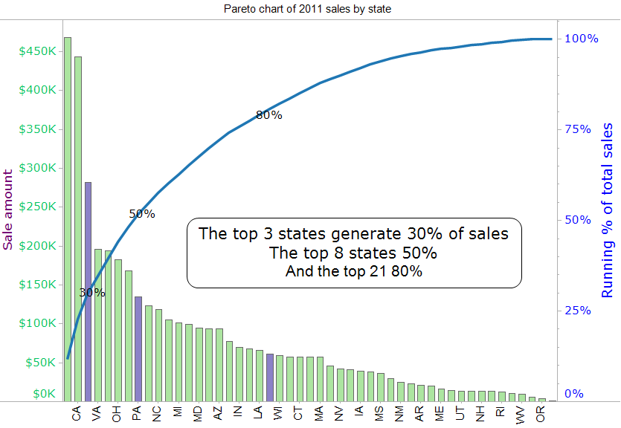
2011 sales by state

Slide 6
Potential sales by state???
What is the sales potential for the top 8 states (based on their current sales)
if we focus direct & newspaper marketing money here?
Find top states based on sales per capita
then apply this
formula to estimate potential sales
  Average sale per capita for top states
  multiplied by
  Current population of top sales states

Slide 7
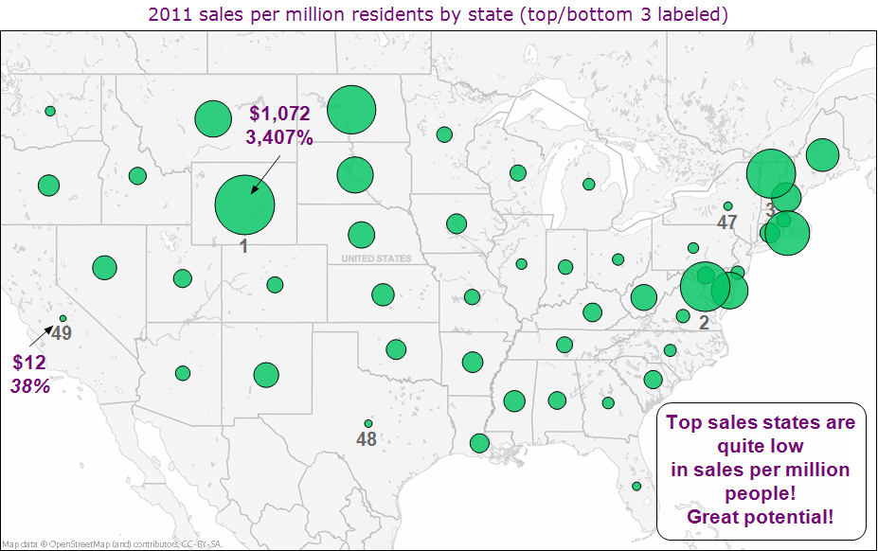
What are the top states based on sales per capita?

Slide 8
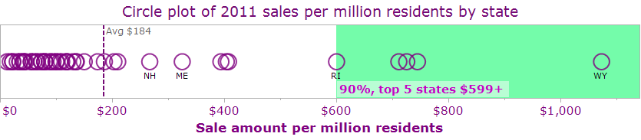
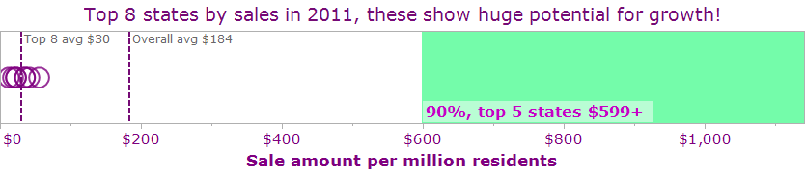
Top states ─ sales per capita?
Whether we use the overall average
–OR– the 90th percentile (top 5 states),
there appears to be great potential in the current top 8 sales states!

Slide 9
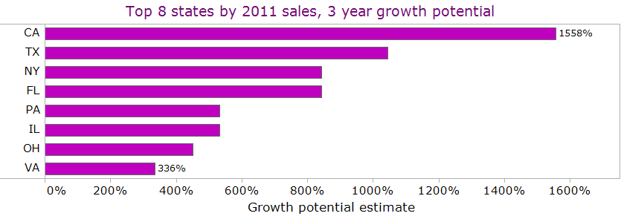
Highest growth potential in top 8
If we were to pick just one state, California has the greatest potential
The next tier is Texas, New York & Florida

Slide 10
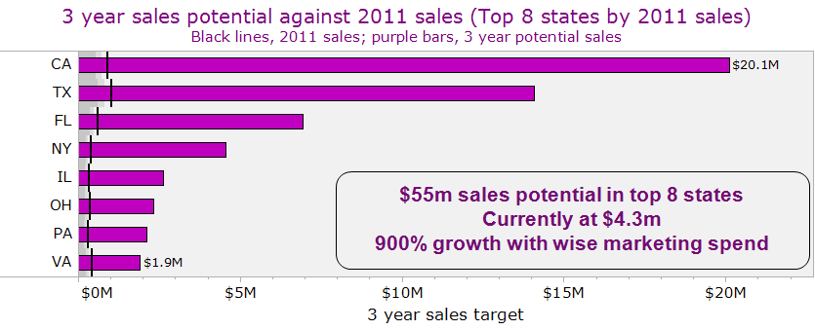
3 year sales potential for top 8
Using the more conservative overall US average of sales per million as our market potential by state, we have plenty of growth opportunity in all top 8 states

